Slide 1
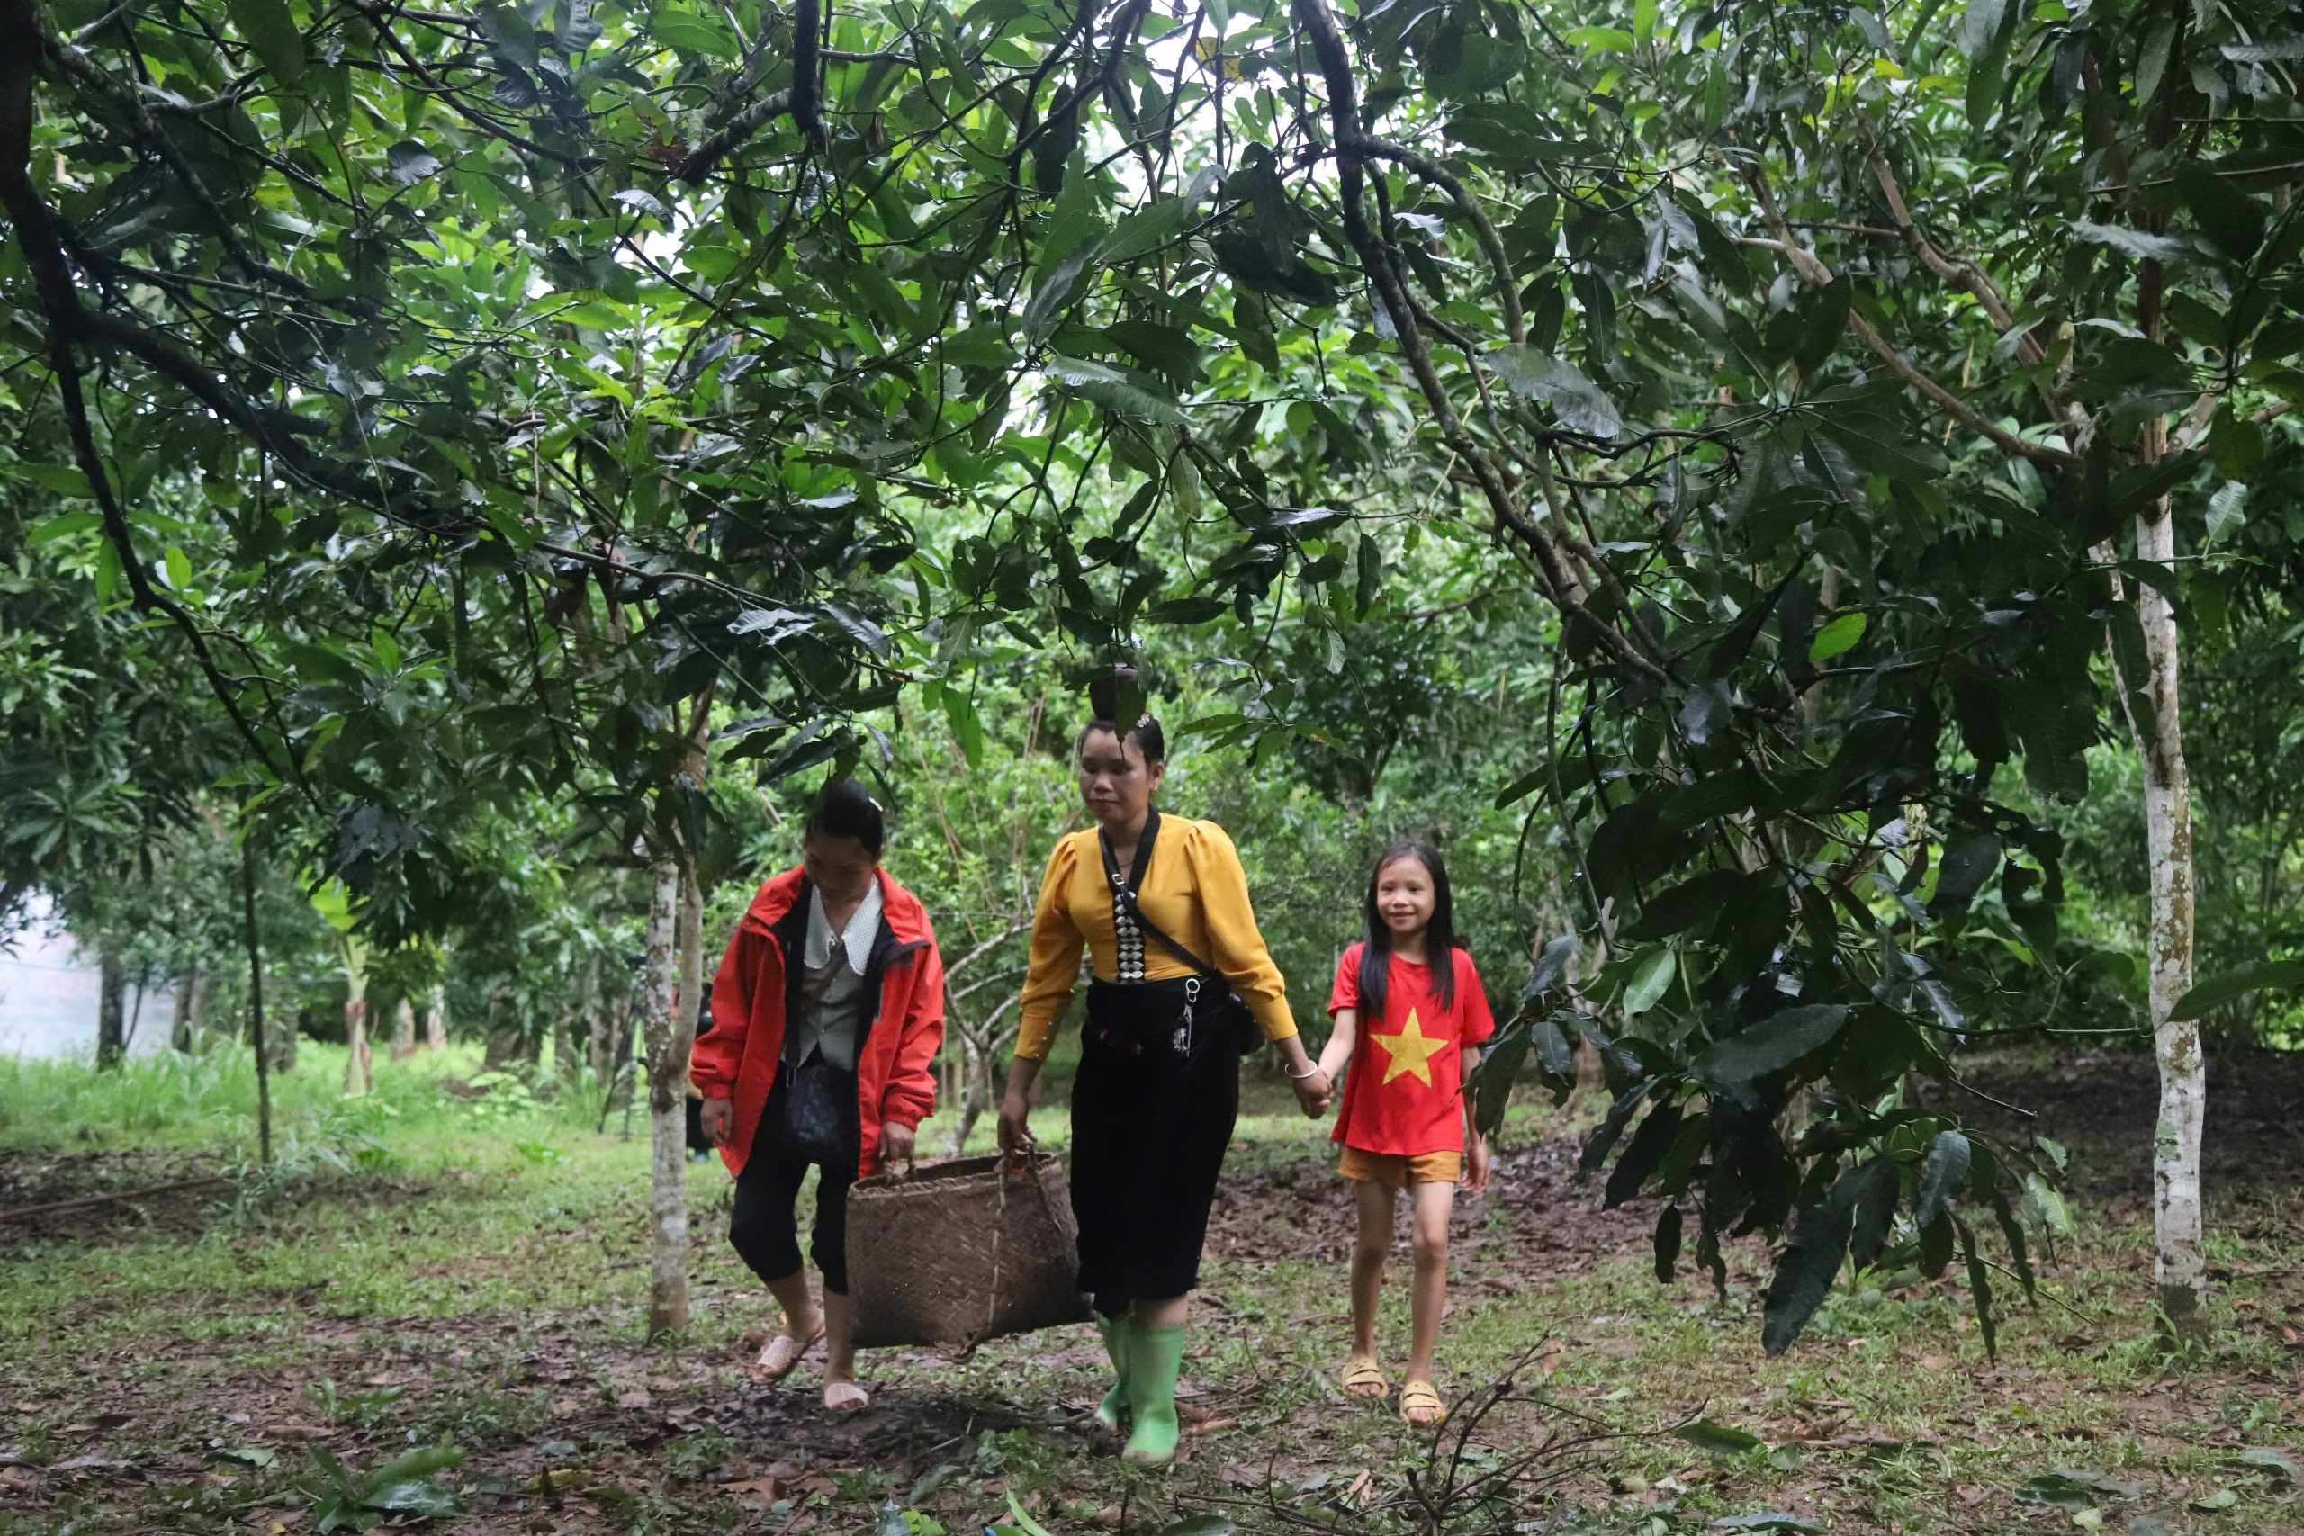
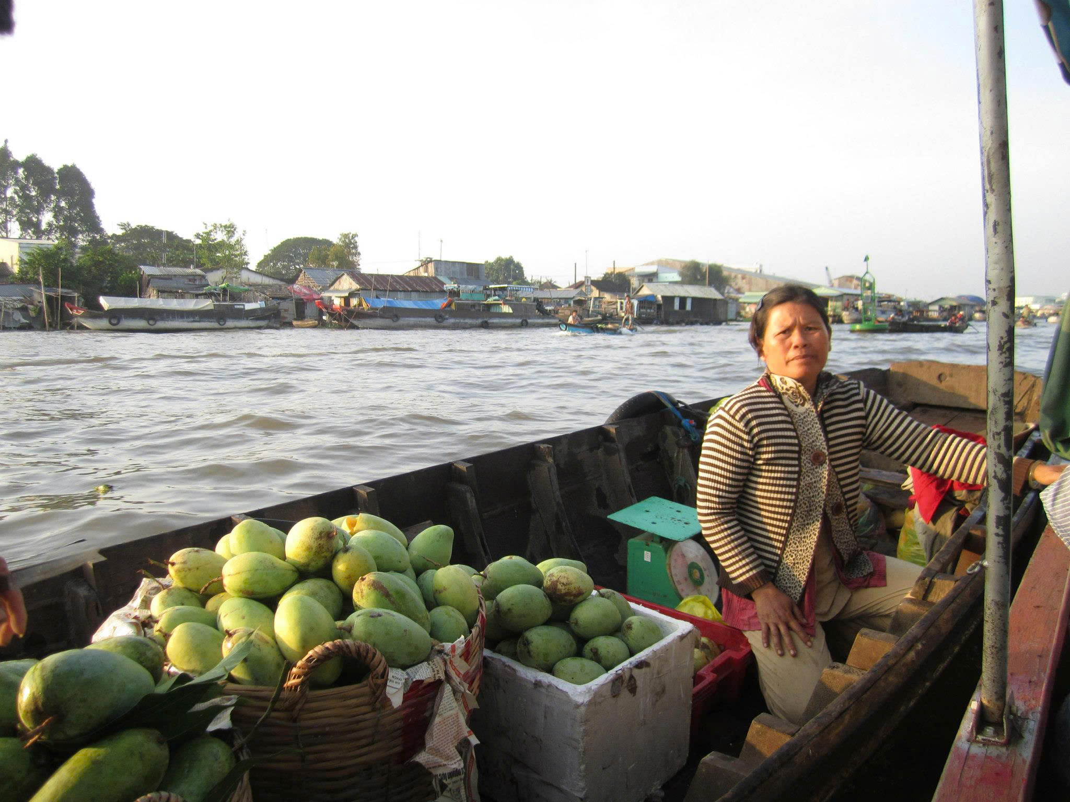
Food Resilience Seminar: Scaling Innovative Solutions to Ensure Food Resilience and Autonomy in the Asia-Pacific
Enhancing resilience of food systems in Viet Nam
How implementing the National Action Plan on Food Systems Transformation (NAP-FST) can contribute
Dao The Anh
Huynh Thi Thanh Tuyen
Nguyen Minh Quoc

Slide 2
What is food system resilience?
A resilient food system can…
FOOD SYSTEM RESILIENCE
The capacity over time of a food system and its actors to keep providing sufficient, appropriate and accessible food to all, in the face of shocks and stresses (Tendall et al., 2015; FAO, 2021)
1
Resist and absorb
Withstand shocks through buffers, stocks, diversity and redundancy
2
Adapt and recover
Adjust practices, markets and policies, and bounce back
Actor view: the ability of food system actors to maintain, protect or recover its key functions despite shocks (Béné et al., 2023)
3
Transform
Change the system when it can no longer cope, and bounce forward more fairly
Note: resilience and sustainability overlap but differ. Resilience is about responding flexibly to shocks; sustainability is about using resources steadily and wisely.
Sources: Tendall et al. (2015); FAO (2021); Béné et al. (2023); HLPE (2025)
Notes:
Food system resilience (Tendall et al., 2015, Global Food Security 6, p. 19): "capacity over time of a food system and its units at multiple levels, to provide sufficient, appropriate and accessible food to all, in the face of various and even unforeseen disturbances".
FAO (2021, State of Food and Agriculture, p. 6) uses almost the same wording for agrifood systems and adds the livelihoods of the actors in them.
Actor view: the ability of individual and institutional actors to "maintain, protect, or successfully recover the key functions" of the food system despite shocks (Béné et al., 2023, p. 1438).
A resilient food system can: resist and absorb shocks (robustness, buffers, redundancy); adapt and recover (adjust practices, markets and policies; bounce back); and transform when the old system is untenable, to "bounce forward" in equitable ways (HLPE, 2025).
Resilience is not the same as sustainability: sustainability is about keeping the system going in the long run; resilience is about coping with disturbances along the way. The newer HLPE framing asks resilience to reduce inequality, not just restore the pre-shock state.

Slide 3
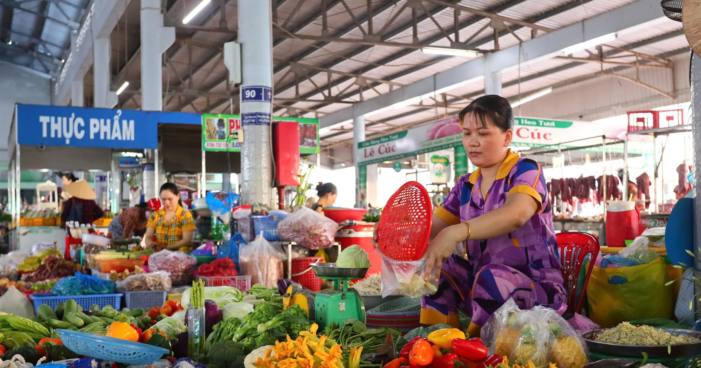
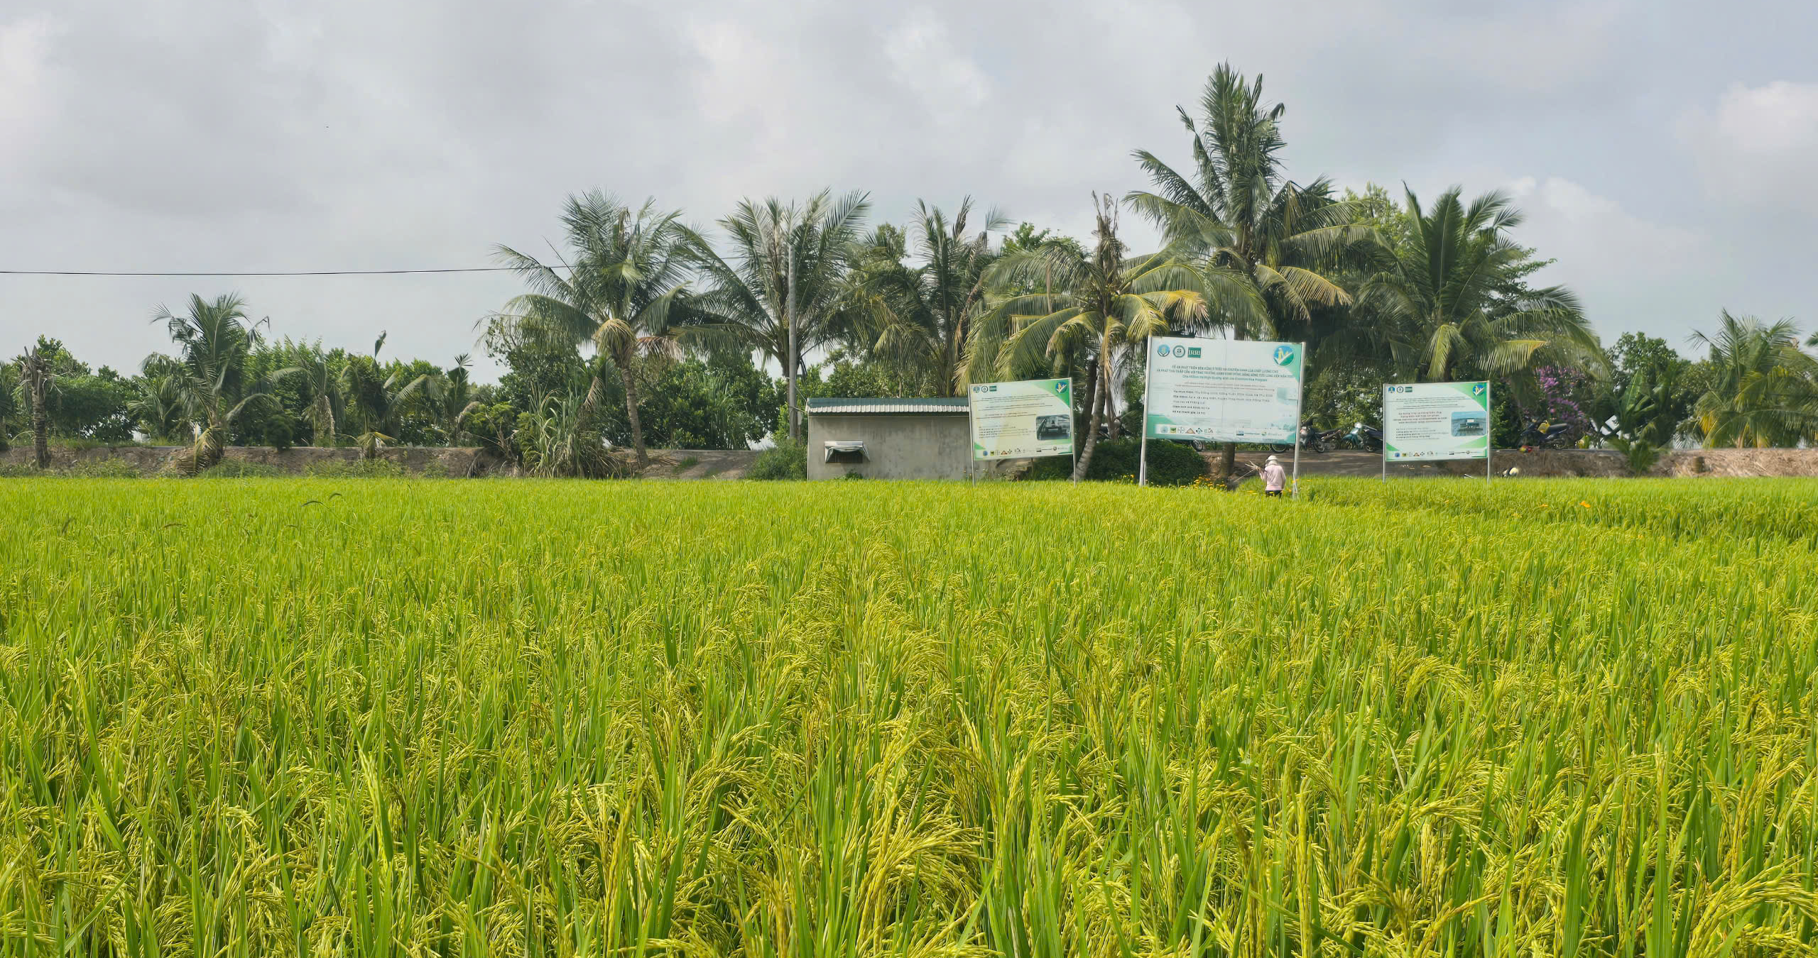
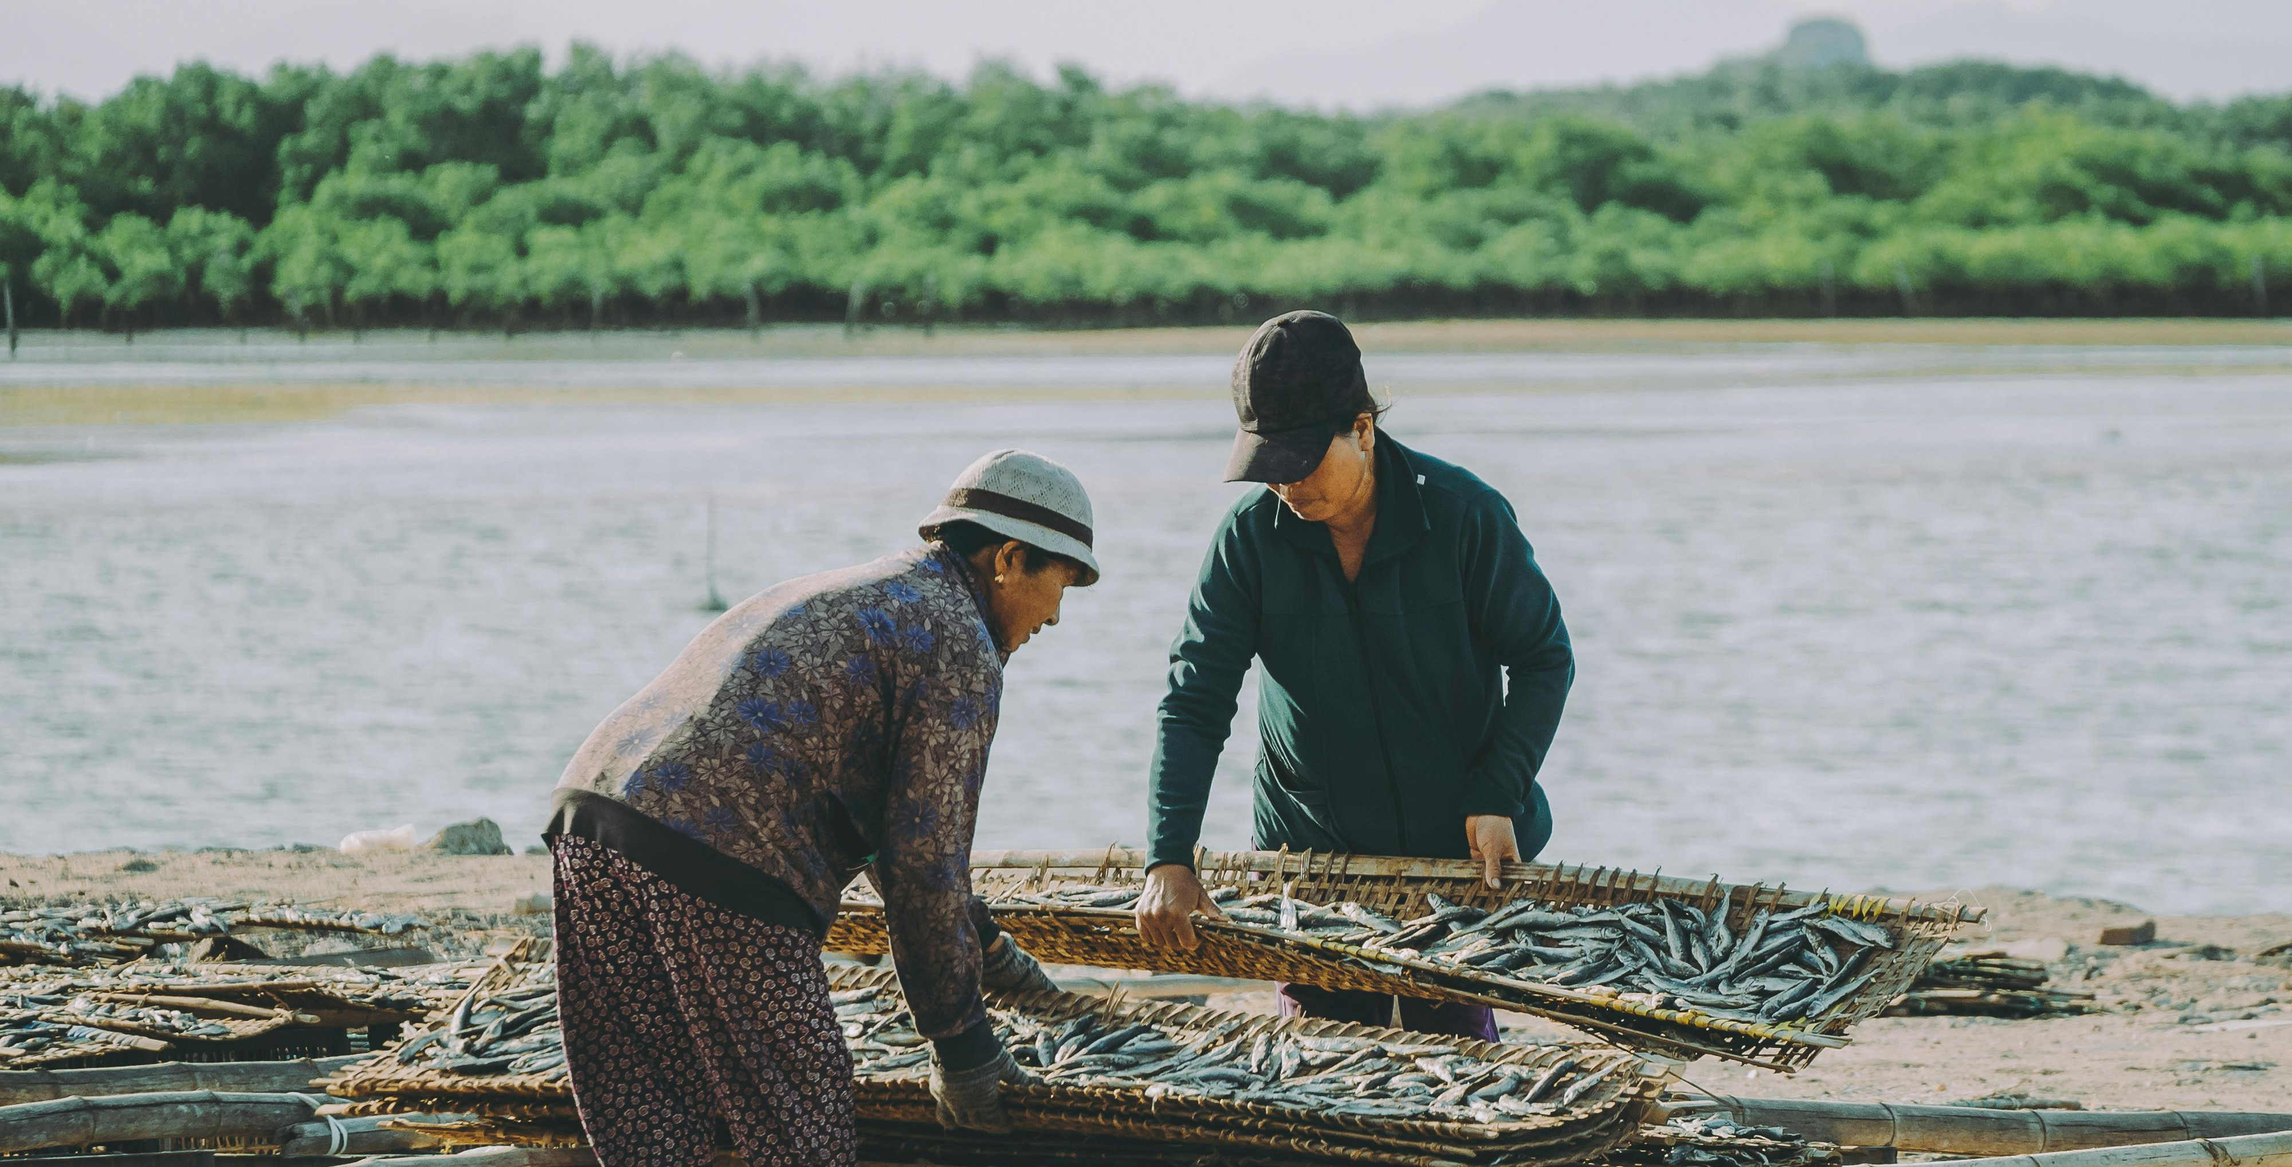
Unpacking resilience in Viet Nam
Resilience of what?
Resilience to what?
Resilience for whom?
Food security and exports
Smallholder livelihoods
Diets and nutrition
Territorial agri-food landscape
Typhoons, floods, drought
Salinity in the Mekong Delta
Price shocks (e.g. 2007-08)
Diseases (e.g. COVID-19)
Long-term stresses: land degradation, migration, pollution
Smallholders in rural areas
Ethnic minority population
Coastal and mountainous communities
Low-income urban households
Women, youth, elderly, people with disability
Sources: Hoang (2018); Nguyen et al. (2019); Bruckert & Nguyen (2024); Dawe & Slayton (2011)
Notes:
Resilience of what? Rice-based national food security and exports; smallholder and household livelihoods; diets and nutrition; territorial food systems (Mekong Delta, northern uplands).
Resilience to what? Climate: typhoons (Yagi, 2024), floods, drought, salinity intrusion in the Mekong Delta. Markets: rice and input price shocks (2007-08). Pandemics: COVID-19 (2020-21). Long-term stresses: land degradation, urbanisation, the nutrition transition.
For whom? Smallholders, ethnic minority and mountain communities, low-income urban households, women, workers along the value chain.
Evidence from Viet Nam:
- Price and income shocks push poor households towards rice at the expense of diverse diets (Hoang, 2018).
- Mekong Delta farming systems facing salinity: recovery depends on credit, off-farm income and fresh water; rice-oriented policy makes it harder to switch systems (Nguyen et al., 2019).
- Moc Chau (Son La) under COVID-19: diverse food sources, decentralised flows and low reliance on external inputs kept the local food system working (Bruckert & Nguyen, 2024).
- 2007-08 rice crisis: export restrictions, Viet Nam's among them, helped turn an adequately supplied market into a price spike (Dawe & Slayton, 2011).
Key message: diversity, finance and sound policy decide who copes. Most evidence is household- or farming-system-level; there is no national resilience assessment for Viet Nam yet.

Slide 4
How to build resilient food systems?
Adapted from Biggs et al. (2012) and Wood et al. (2023), with critical examples from Viet Nam
1
Keep diversity and redundancy
2
Manage connectivity
3
Watch slow variables
+
A mix of food sources and supply routes kept food reaching households in Moc Chau during COVID-19. (Bruckert & Nguyen, 2024)
–
Rice export bans in 2007-08, Viet Nam's included, turned ample supply into a price spike. (Dawe & Slayton, 2011)
–
Salinity in the Mekong Delta creeps up year by year, and rice-focused policy makes it hard for farmers to switch. (Nguyen et al., 2019)
4
Learn and experiment
5
Broaden participation
6
Share governance
+
Farmer Field Schools let farmers test practices and decide together, but were never scaled up. (van de Fliert et al., 2007)
–
In Ca Mau, resource policies relied on state control and did little for household resilience. (Tran, 2012)
+
PGS groups in the Red River Delta share organic certification and make households more resilient. (Thi et al., 2026)
Sources: Biggs et al. (2012); Wood et al. (2023); Bruckert & Nguyen (2024); Dawe & Slayton (2011); Nguyen et al. (2019); van de Fliert et al. (2007); Tran (2012); Thi et al. (2026)
Notes:
Seven generic principles for enhancing resilience (Biggs et al., 2012, Annual Review of Environment and Resources 37): (P1) maintain diversity and redundancy, (P2) manage connectivity, (P3) manage slow variables and feedbacks, (P4) foster an understanding of social-ecological systems as complex adaptive systems, (P5) encourage learning and experimentation, (P6) broaden participation, (P7) promote polycentric governance. On the slide, P4 and P5 are combined. The principles often co-occur and depend on each other.
Viet Nam examples (critical reading):
1. Diversity and redundancy (+): in Moc Chau (Son La), diverse food sources, decentralised flows and low reliance on external inputs kept the local food system working during COVID-19 (Bruckert & Nguyen, 2024). Hertel et al. (2021) call diversification the most fundamental lever.
2. Connectivity (-): connectivity can spread or dampen shocks. In 2007-08, export restrictions by major exporters, Viet Nam among them, helped turn an adequately supplied rice market into a price spike (Dawe & Slayton, 2011).
3. Slow variables (-): in the coastal Mekong Delta, rising salinity is a slow stress; farmers' recovery depends on credit, off-farm income and fresh water, and rice-oriented policy makes it harder to change systems (Nguyen et al., 2019). Land degradation in Moc Chau is another slow variable.
4. Learning and experimentation (+, with a caveat): Farmer Field Schools, introduced in Viet Nam in 1992, built farmers' agroecological knowledge, critical skills and collective action; farmers learned to make informed decisions and manage their farms independently. Despite convincing impact at farmer level, the model was not widely mainstreamed into the extension system (van de Fliert et al., 2007).
5. Participation (-): in Ca Mau, shrimp-mangrove and fisheries policies aimed at social-ecological resilience did not necessarily raise households' social and economic resilience; control and enforcement alone are not enough (Tran, 2012).
6. Polycentric governance (+): Participatory Guarantee Systems (PGS) share the guarantee of organic produce among farmer groups, consumers, traders and local authorities. In PGS cabbage-growing households in the Red River Delta, social safety nets (notably local farmer groups and organisations), assets and access to basic services were the three most important pillars of resilience, and more resilient households were more profitable (Thi et al., 2026).
Key message: the principles help, but they can pull against each other (e.g. trade connectivity vs self-sufficiency), so trade-offs have to be negotiated (Zurek et al., 2022).

Slide 5


Policy journey towards food systems transformation in Vietnam
2002-2008: Resolutions 15-NQ/TW and 26-NQ/TW: Improving quality and developing value chains
Before 1986: Centrally planned economy
1988: Resolution 10-NQ/TW (Contract 10): Output breakthrough
2013: Decision 899/QĐ-TTg on agricultural restructuring: Focus on raising added value and sustainable development
2021: National Green Growth Strategy (Decision 1658/QĐ-TTg) and commitment to transparent, responsible and sustainable food systems transformation
2022: Resolution 19-NQ/TW: Shift toward multi-value agriculture and ecological agriculture
Where resilience enters the journey
2017: Resolution 120/NQ-CP: sustainable, climate-resilient Mekong Delta
2023: NAP-FST links food systems transformation to “resilience to shocks”; Viet Nam joins the COP28 Emirates Declaration on resilient food systems
2023: National Action Plan for Food Systems Transformation towards Transparency, Responsibility and Sustainability in Vietnam until 2030 (Decision 300/QĐ-TTg) (NAP-FST)
Policy focus: Output and economic value
Focus on agriculture
Policy moved from producing more, to producing better, to fair, sustainable food systems that cope with shocks.
Notes:
Có thể bỏ slide này vì nó thuộc cấp quốc gia
Speaker points: the shift is from sector-by-sector plans (output and economic value) to one coordinated, cross-ministry plan with measurable targets. Key steps: UNFSS national dialogues (2021) led by MARD, NIN and VAAS produced the National Pathway; Strategy for Sustainable Agriculture and Rural Development 2021-2030 (Decision 150/QD-TTg, 2022); Resolution 19-NQ/TW (2022); NAP-FST (Decision 300/QD-TTg, 28 March 2023). Later: Ministry of Health implementation plan 546/KH-BYT; COP28 Emirates Declaration on Resilient Food Systems; FST-Partnership endorsed (Letter 6483/VPCP-QHQT); MARD and MONRE merged into MAE (2025); NAP-FST mid-term report due 2026.
Where resilience enters the journey: Resolution 120/NQ-CP (17 Nov 2017) on sustainable and climate-resilient development of the Mekong Delta; NAP-FST (Decision 300/QD-TTg, 2023) names 'resilience to shocks' among the aims of food system transformation; Viet Nam took part in COP28 and the Emirates Declaration on Sustainable Agriculture, Resilient Food Systems and Climate Action (2023) (SHiFT country case, Honeycutt et al., 2025). Alignment: the journey moved from output (Contract 10) to quality and value (2000s-2013), to green growth and multi-value, ecological agriculture (2021-2022), to a whole food system approach (2023). Resilience follows the same path: from protecting output to protecting people, livelihoods and ecosystems.

Slide 6
NAP-FST principles and resilience principles
Decision 300/QĐ-TTg links food system transformation to agroecology, competitiveness and “resilience to shocks”.
NAP-FST principle
Resilience principles
Why they connect
Transparency
Learn and experiment
Traceability and shared data help actors spot shocks early and keep information moving
Manage connectivity
Responsibility
Broaden participation
When farmers, firms, consumers and the state each carry their share, risk is spread and the vulnerable are protected
Share governance
Sustainability
Keep diversity
Agroecology and careful use of land and water keep buffers in place and hold slow stresses in check
Watch slow variables
Source: Decision 300/QĐ-TTg (2023) and Biggs et al. (2012)
Notes:
Argument: the three NAP-FST principles line up with the principles for building resilience on slide 4 (own synthesis based on Decision 300/QD-TTg and Biggs et al., 2012).
Transparency -> learn and experiment; manage connectivity. Traceability, area codes, food balance sheets and data let actors see shocks coming, learn from them and keep information flowing along supply chains.
Responsibility -> broaden participation; share governance. Every actor (input suppliers, farmers, processors, traders, consumers, the state) has a role; shared roles spread risk and protect the most vulnerable.
Sustainability -> keep diversity and redundancy; watch slow variables. Agroecology, low emissions and careful use of land and water keep buffers in place and slow stresses such as soil degradation and salinity in check.
Decision 300 states that food system transformation is linked to agroecology, competitiveness, "resilience to shocks" and the reputation of Vietnamese products. Resilience is therefore one of the plan's own aims, not a separate agenda.

Slide 7
NAP-FST tasks and solutions that build resilience
2030 targets that signal resilience
<5%
households with moderate or severe food insecurity
<15%
stunting in children under 5
−10%
food system greenhouse gas emissions vs 2020
1
2
3
4
5
Policies and standards
Input supply
Production
Processing and distribution
Consumption
Agroecology policy, planning by ecological zone, logistics and M&E
Climate-tolerant varieties, bio-inputs and wholesale hubs
Early warning down to commune level, insurance and One Health
Storage for disruptions, stable supply chains and less loss
Food balance sheets, a pilot food bank and healthy diets
Sets the rules for adapting and transforming
Cuts dependence on costly inputs
Helps farms absorb climate and disease shocks
Stocks and storage keep food moving
Protects the people most at risk
Source: Decision 300/QĐ-TTg (2023), Section III and Appendix
Notes:
NAP-FST task areas and how they build resilience:
- Policies and standards: agroecology and low-emission policy; planning by ecological zone; PPPs for logistics and cold chains; M&E indicators. They set the rules that let the system adapt and transform.
- Input supply: climate-tolerant varieties; organic fertiliser and bio-pesticides; wholesale markets as logistics hubs. Less dependence on costly external inputs.
- Production: digital weather, pest and market warnings down to commune level; agroecological protocols; nutrition-sensitive agriculture in mountain and ethnic minority areas; One Health; risk management and agricultural insurance. Helps absorb climate and disease shocks.
- Processing and distribution: storage to buffer supply disruptions, prioritising the poor; stable supply chains; food loss and waste reduction; e-commerce. Buffers and redundancy keep food moving.
- Consumption: national and provincial food balance sheets; a pilot food bank; healthy and responsible consumption. Protects the most vulnerable.
2030 targets that signal resilience: severe or moderate household food insecurity below 5%; stunting below 15%; food system GHG emissions down 10% from 2020; post-harvest losses down 0.5-1% a year; GAP or equivalent above 30% of output.
Speaker point: many NAP-FST tasks already work as resilience measures even though they are not labelled that way; naming them as such helps set priorities and design monitoring.
Source: Decision 300/QD-TTg (2023), Section III and Appendix.

Slide 8
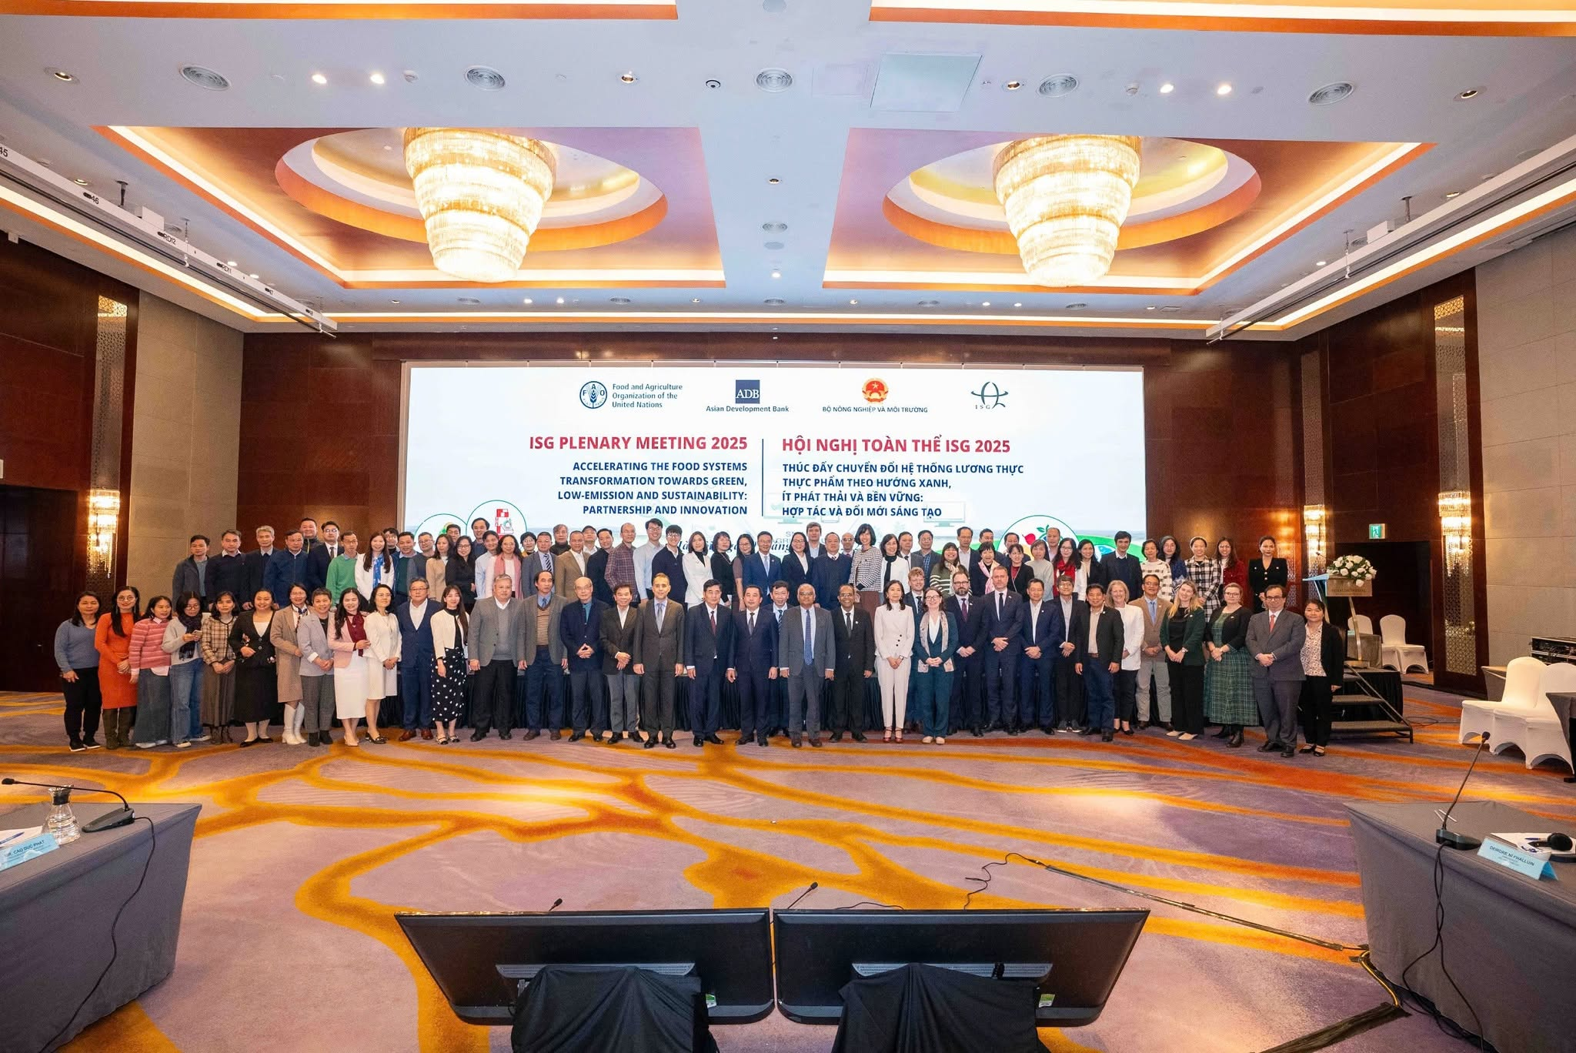
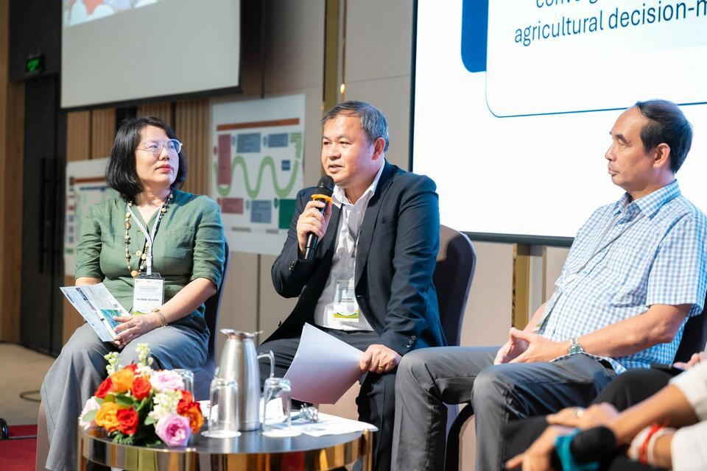
Implementing NAP-FST at national level
Institutions and policies
MAE assigned NAP-FST tasks to its agencies (Decision 4812, Nov 2023) and leads the FST-Partnership with 51 partners. The Ministry of Health issued its own plan (546/KH-BYT, Apr 2023), and provinces are building the plan into their programmes.
Monitoring and evaluation
M&E indicators were completed in 2023-2024. A detailed implementation plan (FST-PIP) was drafted in 2025 to turn the tasks into funded actions.
Sharing and dialogue
Viet Nam shares its experience in global forums such as FAST, COP28 and COP29, while national dialogues spread successful models of agroecology, nutrition and climate adaptation.
How this builds resilience: clear roles and coordination across ministries mean faster, joined-up responses to shocks. M&E flags problems early, and partnerships pool money and expertise.
Sources: Decision 300/QĐ-TTg (2023); MAE overview of NAP-FST implementation
Notes:
National implementation of NAP-FST (translated and combined from the Vietnamese slides on institutions and policies, and on M&E and resource mobilisation).
Institutions and policies: Decision 300/QD-TTg (28 March 2023) approved the National Action Plan. Ministry of Agriculture and Environment (MAE): Decision 4812/QD-BNN-HTQT (13 Nov 2023) assigning NAP-FST tasks; the Partnership Agreement on transparent, responsible and sustainable food systems transformation (FST-Partnership) with ministries, local authorities and 51 partners. Ministry of Health: Plan 546/KH-BYT (25 April 2023) implementing Decision 300 within the health sector; Official Letter 6720/BYT (19 Oct 2023) assigning tasks. Provinces: develop plans to implement Decision 300 and integrate its content and tasks into provincial plans and programmes.
M&E and resources: M&E indicator set for the Plan completed (2023-2024); 5 inter-sectoral technical working groups set up (2025): (i) policy and institutions, (ii) agroecology, (iii) food loss and waste, (iv) nutrition and local food diversification, (v) responsible distribution and consumption; draft detailed implementation plan (FST-PIP, 2025: 37 tasks); multi-stakeholder resource mobilisation and technical support.
Sharing and dialogue: active participation in global forums (FAST partnership; the coalition of pioneer countries for food systems transformation; COP28, COP29); national dialogues to spread successful models of agroecology, nutrition improvement and climate adaptation.
2026 priorities (from the earlier timeline slide): strengthen capacity at central and local levels (training, M&E); support two pilot provinces (Son La with ADB, Dong Thap with VN Adapt); mobilise resources; stocktaking by FS partners; develop an implementation programme; mid-term report.
How this builds resilience: clear mandates and cross-ministry coordination mean faster, joined-up responses when shocks hit; M&E gives early signals and lessons; partnerships pool finance, data and expertise; working groups on agroecology, nutrition and food loss target the buffers that protect food security.

Slide 9
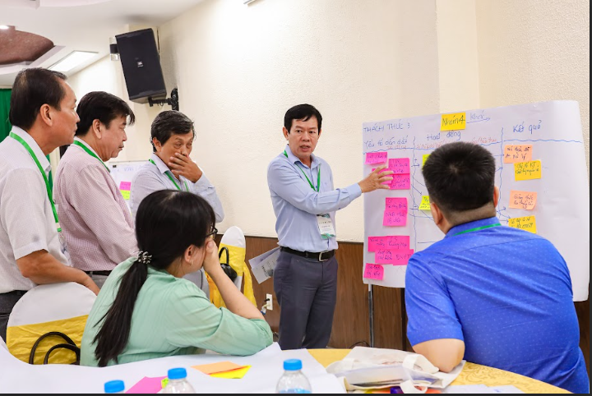
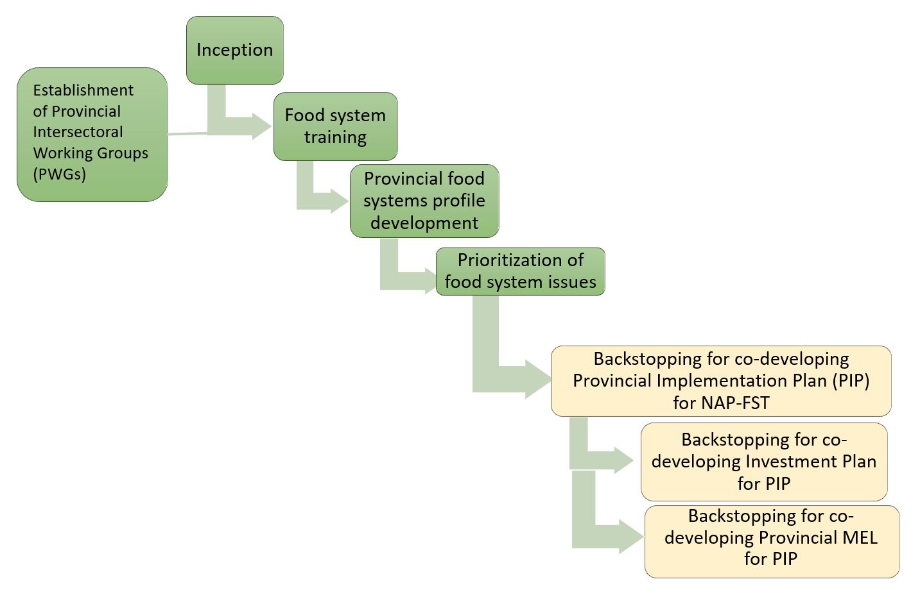
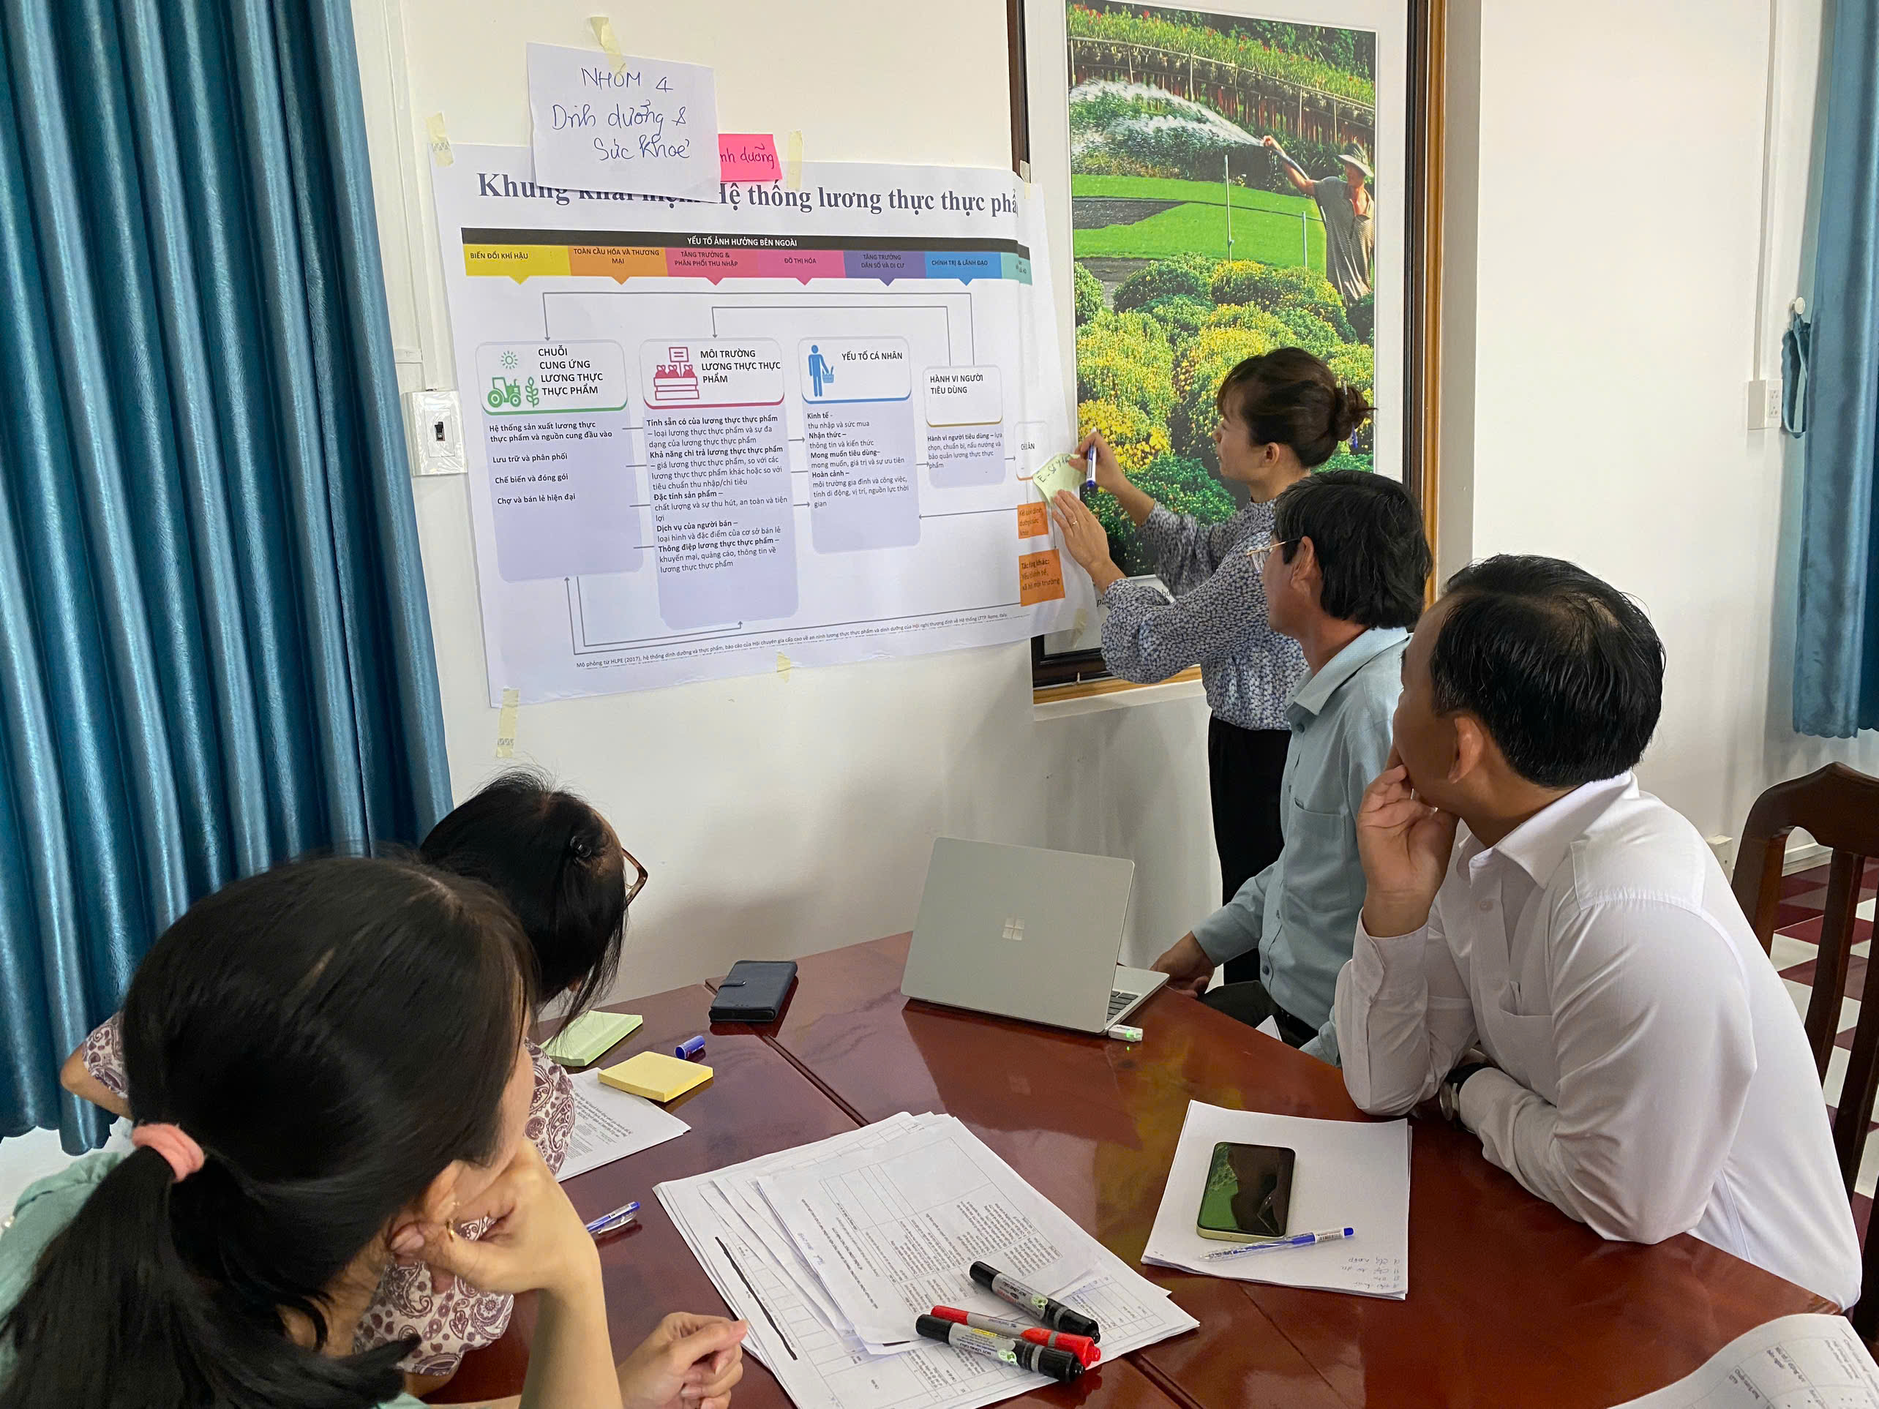
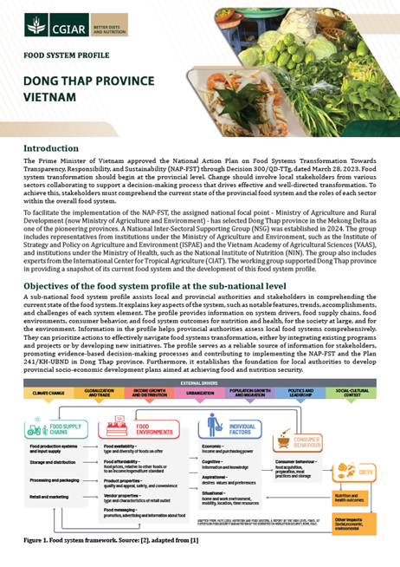
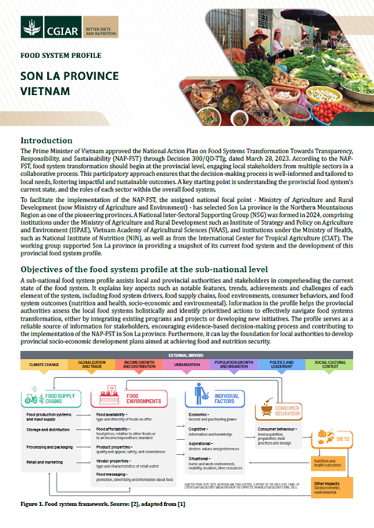
Sub-national implementation
The Food Systems Transformation Decision Support (FSDS) process in Đồng Tháp and Sơn La, 2024-2026
Leverage points for resilience
Agroecology
Diverse farms that buy fewer inputs cope better with price and climate shocks, as Moc Chau showed during the pandemic.
Sơn La: organic, agroforestry and agritourism models
Đồng Tháp: linking the rice-lotus-fish value chain
Healthy diets
After a price or income shock, poor households cut other foods to buy rice; diverse local food protects their diets.
Sơn La: a healthy food bank pilot, nutrition models for ethnic minority areas and healthier school meals
Đồng Tháp: farmer groups in local chains linking production, processing and consumption
Sources: Sơn La Plan 161/KH-UBND (2025); Lundy et al. (2026); Bruckert & Nguyen (2024); Hoang (2018); MAE (2025)
Notes:
Sub-national pilots (translated from the Vietnamese slide): pilots in Son La and Dong Thap. The Food Systems Transformation Decision Support process (FSDS) in Son La:
2024: kick-off meeting and set-up of the provincial technical working group (June 2024); training on food systems (Sept 2024); food system profile (Oct-Nov 2024); identifying priority food system issues (Nov 2024); sharing lessons among partners.
2025-2026: support for the provincial implementation plan (Jan-Jul 2025); support for a multi-sector investment plan (Sept 2025 - Jul 2026); documenting the process (Jan-Dec 2026).
Result: Son La's provincial plan for food systems transformation was issued as Plan 161/KH-UBND on 29 July 2025, implementing Decision 300/QD-TTg.
Leverage points for resilience:
- Agroecology: diverse farms with fewer purchased inputs and healthier soils are less exposed to input-price and climate shocks. In Moc Chau (Son La), diverse food sources, decentralised flows and low reliance on external inputs kept the local food system working during COVID-19 (Bruckert & Nguyen, 2024). Son La links agroecology with tourism.
- Healthy diets: after price and income shocks, poor households shift to rice at the expense of other foods (Hoang, 2018). Demand for diverse local foods supports diverse production, and nutrition-sensitive programmes (an NAP-FST task for mountainous and ethnic minority areas) protect the most vulnerable. NAP-FST 2030 targets: stunting below 15%, overweight and obesity below 20% in adults.
Speaker point: provinces are where resilience is built, because shocks are local; agroecology and healthy diets give provinces concrete entry points that serve both transformation and resilience.
Models named in Son La's provincial plan (Plan 161/KH-UBND, 29 July 2025): a healthy food bank pilot for poor and vulnerable groups; a nutrition-secure food system model for disadvantaged, ethnic minority and remote areas; healthy food distribution through markets, stores and school food supply networks; front-of-pack nutrition labels and community brands; agritourism models linking farming with rural tourism and local cuisine; production approaches including agroecology, organic farming, GAP, IPHM, agroforestry and circular, low-emission agriculture. Named local products include Moc Chau Shan tuyet tea, Son La coffee and Yen Chau round mango (geographical indications) and Moc Chau safe vegetables.
Đồng Tháp: priorities are linking the rice-lotus-fish value chain, reducing post-harvest losses and raising the share of processed produce, with farmer groups in controlled local supply chains that connect production, processing and consumption (MAE, 'From policy to the field', 4 Nov 2025). Nghe An, a third pilot, focuses on nutrition-sensitive agriculture, food diversity and school meals.

Slide 10

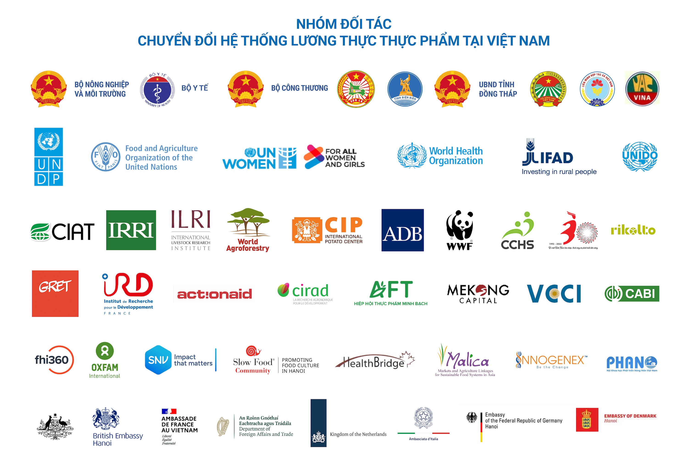
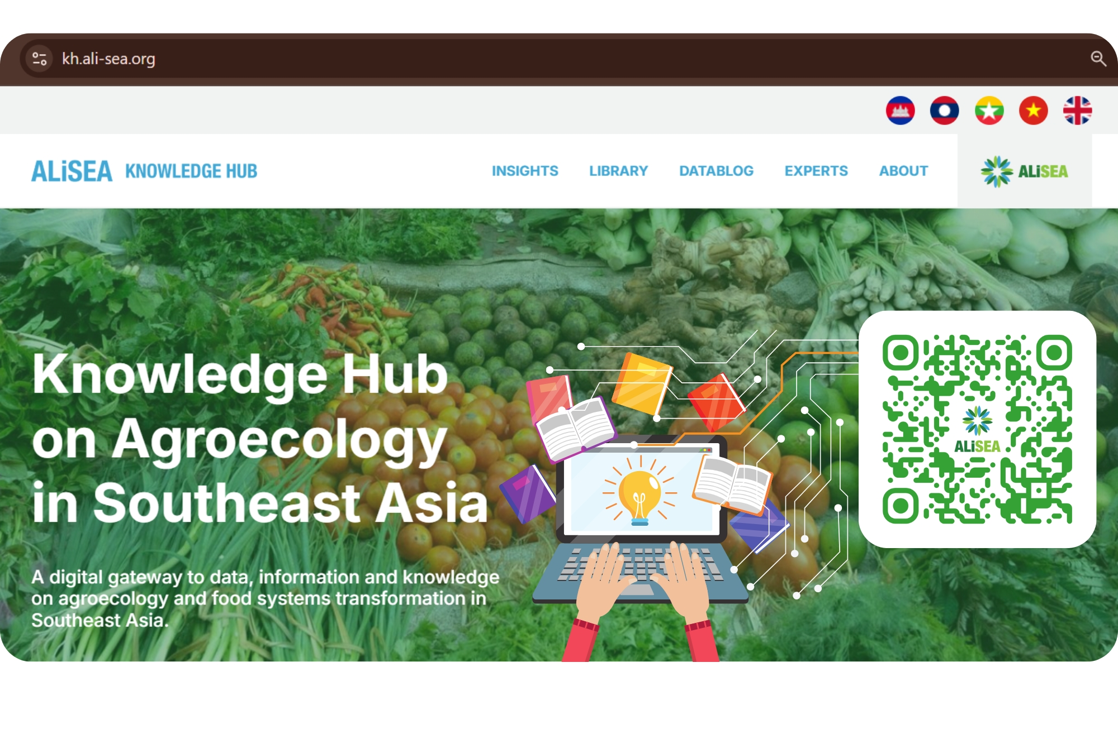
Platforms for multi-stakeholder actions
partners
50+
FST-Partnership
ALiSEA
~200
members
A government-endorsed partnership, chaired by MAE, that brings ministries, provinces, UN agencies, donors, research, NGOs and businesses together to implement NAP-FST through five technical working groups.
The Agroecology Learning Alliance in South East Asia: a network of NGOs, farmer groups, researchers, businesses and government in five Mekong countries that shares knowledge, supports policy dialogue and offers small grants.
Platforms bring agriculture, health, trade and environment together. Information moves earlier, actors build their capacity, and responses to shocks can be coordinated.
Notes:
FST-Partnership: a government-endorsed platform (Letter 6483/VPCP-QHQT) chaired by MAE, signed by 3 ministries and 30 partners; it now engages 51 partners (MAE overview of NAP-FST implementation; earlier counts: UNDP 47 in June 2025, Alliance report 49+). Members include government, UN agencies (FAO, UNDP and others), development partners, research organisations (CGIAR and others), NGOs and businesses. Focus: strategic partnerships, finance for agriculture, knowledge and capacity building, and 5 technical working groups.
ALiSEA (Agroecology Learning Alliance in South East Asia): a regional agroecology network in Cambodia, Laos, Myanmar, Thailand and Viet Nam with about 200 members (NGOs, farmer organisations, research, private sector and government). It works on knowledge sharing, awareness, policy dialogue, capacity building and small grants, and links agroecology practice with policy, including the consultation on ASEAN guidelines on agroecology policy (Nov 2025) [check the guideline's name].
Why platforms matter for resilience: they connect sectors that otherwise work separately (agriculture, health, trade, environment), share early information, pool resources and coordinate responses when shocks hit. Platforms are part of the social infrastructure of resilience: connectivity, trust and coordination.

Slide 11
What should be prioritized next?
1
Make resilience measurable
2
Produce sustainably and diversely
3
Safer food, less waste
Add resilience indicators to NAP-FST monitoring and the 2026 mid-term review, and assess resilience province by province
Low-emission crops, 1 million ha of low-emission rice, agroecology and circular farming, without locking into one commodity
Stronger standards and traceability, healthy and responsible consumption, and less food loss and waste
4
Reduce risk, protect the vulnerable
5
Technology and a stronger midstream
6
Fund and coordinate
Forecasting, early response and insurance, backed by social protection, food reserves and nutrition programmes
Better breeding, processing and digital value chains, plus wholesale markets, cold chains and storage
Provincial budgets plus climate and private finance; the FST-Partnership and ALiSEA for early warning and dialogue
Aim to bounce forward: recovery after a shock should leave food systems fairer and greener than before.
Notes:
What should be done next: six combined priorities (MAE priority directions plus resilience recommendations).
1. Make resilience measurable: add resilience indicators to the NAP-FST M&E system and the 2026 mid-term review, covering shock exposure, capacities and food security outcomes; assess food system resilience at national and provincial level, using food system profiles to map shocks, vulnerable groups and critical points such as wholesale markets, logistics and storage.
2. Produce sustainably and diversely: emission reduction projects in crop production; the sustainable development project of one million hectares of high-quality, low-emission rice in the Mekong Delta; agroecology, circular agriculture, nature-based solutions and green agriculture. Diversify crops and diets, markets and supply sources, and household incomes; avoid policies that lock in single-commodity systems.
3. Safe food, responsible consumption, less waste: review regulations on product standards, quality, traceability and information; promote sustainable and responsible consumption and healthy diets; reduce food loss and waste.
4. Reduce disaster risk and protect the vulnerable: monitoring, forecasting, response measures, risk-sharing mechanisms and insurance; shock-responsive social protection, food reserves and food banks, nutrition-sensitive programmes in mountain and ethnic minority areas.
5. Science, technology and a stronger midstream: priority to breeding and hybridisation, high technology in livestock farming, processing and product preservation; digital transformation across the value chain and databases; strengthen wholesale markets, cold chains, storage and digital market information, and include traders and processors in plans.
6. Fund and coordinate: provincial budgets and staff, climate finance, green credit and private investment; use the FST-Partnership's working groups and ALiSEA for early warning, rapid dialogue and shared learning during shocks.
Overall aim: bounce forward. Recovery after shocks should lead to fairer, greener food systems, not just a return to the old ones.

Slide 12
Thank you
Acknowledgements
Notes:
Acknowledgements: add partners, funders and logos here.

